Slide 1
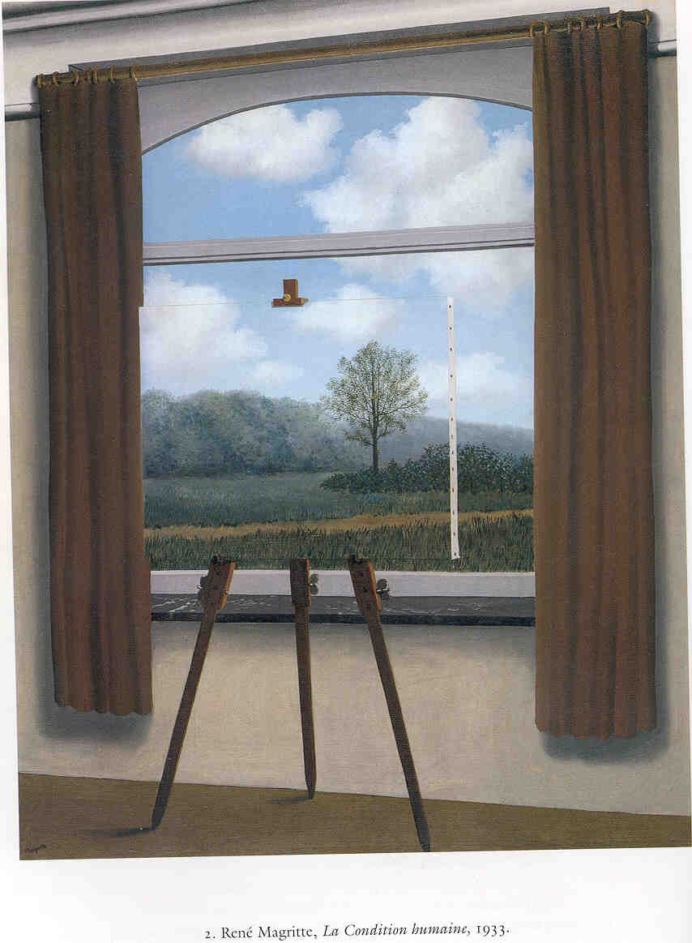
Event Variables and Framing Effects
Paul M. Pietroski
University of Maryland

Slide 2
Outline
Framing effects (e.g., Kahneman and Tversky)
Some puzzles concerning natural language “event variables”
Two chipmunks chased each other.
Alvin joyfully chased Theodore, who joylessly chased Alvin.
There was an event, e1, of Alvin chasing Theodore joyfully.
There was an event, e2, of Theodore chasing Alvin joylessly.
Was e1 (identical to) e2?

Slide 3
Outline
Framing effects (e.g., Kahneman and Tversky)
Some puzzles concerning natural language “event variables”
Two chipmunks chased each other.
Alvin joyfully chased Theodore, who joylessly chased Alvin.
Simon played a song dramatically on his tuba in two minutes.
Simon played his tuba for two minutes.
There was an event, e1, of Simon playing a song...
There was an event, e2, of Simon playing his tuba...
Was e1 (identical to) e2?
*Simon played his tuba dramatically on his tuba in two minutes.

Slide 4
Outline
Framing effects (e.g., Kahneman and Tversky)
Some puzzles concerning natural language “event variables”
Two chipmunks chased each other.
Alvin joyfully chased Theodore, who joylessly chased Alvin.
Simon played a song dramatically on his tuba in two minutes.
Simon played his tuba for two minutes.
With regard to alleged “values of” these event variables...
  Argue against identity responses to the puzzles
  Argue against non-identity responses to the puzzles
Given a truth-theoretic conception of linguistic meaning, certain “event framing effects” yield paradoxes

Slide 5
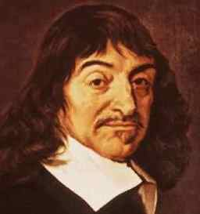
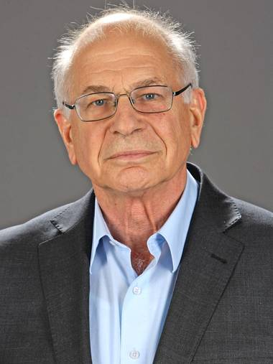
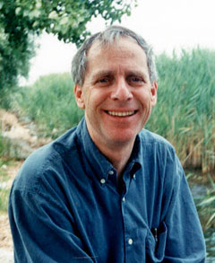
I Cognize, ergo
I am prone to Framing Effects
Examples via Kahneman’s recent book, Thinking Fast and Slow
A bat and a ball cost $1.10
The bat costs a dollar more than the ball
How much does the ball cost?
Hint: NOT ten cents…a dollar is not a dollar more than ten cents
Adam and Beth drive equal distances in a year.
Adam switches from a 12-mpg to 14-mpg car.
Beth switches from a 30-mpg to 40-mpg car.
Who will save more gas?
Adam: 10,000/12 = 833 10,000/14 = 714 saving of 119 gallons
Beth: 10,000/30 = 333 10,000/40 = 250 saving of 83 gallons

Slide 6
I Cognize, ergo
I am prone to Framing Effects
Examples via Kahneman’s recent book, Thinking Fast and Slow
Adam and Beth drive equal distances in a year.
Adam switches from a 1/12-gpm to 1/14-gpm car.
Beth switches from a 1/30-gpm to 1/40-gpm car.
Who will save more gas?
Adam: 1/12 = .083 1/14 = .071 difference = .012
Beth: 1/30 = .033 1/40 = .025 difference = .008

Slide 7
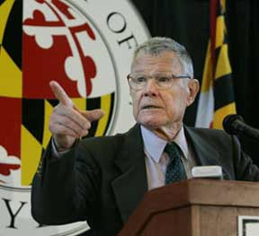
Schelling Effect
Suppose your tax depends on your income and how many kids you have.
The “child deduction” might be a flat rate, say $1000 per child
Tax(i, k) = Base(i) – [k • 1000]
Or the deduction for each child could depend on the taxpayer’s income
Tax(i, k) = Base(i) – [k • Deduction(i)]
Q1: Should the child exemption be larger for the rich than for the poor?
Instead of taking the “standard” household to be childless, we could assume two kids per household, lower the base tax for everyone (e.g., by $2000), and impose a surcharge on households with fewer than two kids (e.g., $1000 for each child less than 2). We could also let the surcharge depend on income.
Tax(i, k) = LowerBase(i) + [(2 – k) • Surcharge(i)]
Q2: Should the childless poor pay as large a surcharge as the childless rich?

Slide 8
Schelling Effect
Q1: Should the child exemption be larger for the rich than for the poor?
Q2: Should the childless poor pay as large a surcharge as the childless rich?
if you answered ‘No’ to both, then you are not endorsing a coherent policy
as Kahneman puts the point…
the difference between the tax owed by
a childless family and by a family with two children
can be described as a reduction or as an increase
if you want the poor to receive at least the
same benefit as the rich for having children,
then you must want the poor to pay at least the
same penalty as the rich for being childless.

Slide 9
1. ~[Deduction(r) > Deduction(p)] Desire
2. Surcharge(p) < Surcharge(r) Desire
3. for any income i,
Surcharge(i) = Deduction(i) obvious, but also provable
4. Surcharge(r) = Deduction(r) [3]
5. Surcharge(p) < Deduction(r) seems OK [2, 4]
6. Surcharge(p) = Deduction(p) [3]
7. Deduction(p) < Deduction(r) seems bad [5, 6]
8. Deduction(r) > Deduction(p) [7]
9. ⊥ [1, 8]

Slide 10
Q1: should the child exemption be larger for the rich than for the poor?
Q2: should the childless poor pay as large a surcharge as the childless rich?
It might now seem like the answers should be ‘No’ to Q1, and so ‘Yes’ to Q2.
Q3: should the child exemption be flat?
Q4: should there be a flat tax on childlessness?
It still seems that Q4 should be answered negatively. So what should we do?
Q5: should there be a child exemption?
Q6: should we eliminate the child exemption?
Since the current child deduction is flat, poor families with children get more relief (as a percentage of income) than rich families with children.
Q7: should we make the child deduction a percentage of income?
Q8: should we reduce the share of the total tax break given to poor families?

Slide 11
Kahneman’s Conclusion
“The message about the nature of framing is stark: framing should not be viewed as an intervention that masks or distorts an underlying preference. At least in this instance...there is no underlying preference that is masked or distorted by the frame. Our preferences are about framed problems, and our moral intuitions are about descriptions, not substance.”
Maybe it’s not this bad with regard to the moral/political.
(As the village semanticist, I take no stand.)
But there is no guarantee that our “intuitions”
have stable propositional contents.

Slide 12
Outline
✓ Framing effects (e.g., Kahneman and Tversky)
Some puzzles concerning natural language “event variables”
Two chipmunks chased each other.
Alvin joyfully chased Theodore, who joylessly chased Alvin.
Simon played a song dramatically on his tuba in two minutes.
Simon played his tuba for two minutes.
With regard to alleged “values of” these event variables...
  Argue against identity responses to the puzzles
  Argue against non-identity responses to the puzzles
Given a truth-theoretic conception of linguistic meaning, certain “event framing effects” yield paradoxes

Slide 13
Event Variables
(1) Alvin chased Theodore.
Chased(Alvin, Theodore)
(1a) Alvin chased Theodore joyfully.
(1b) Alvin chased Theodore around a tree.
(1c) Alvin chased Theodore joyfully around a tree.
(1d) Alvin chased Theodore around a tree joyfully.
(1c) ⬅➔ (1d)
 
(1a) (1b)
 
(1)

Slide 14
Event Variables
(1) Alvin chased Theodore.
∃e[Chased(e, Alvin, Theodore)]
(1a) Alvin chased Theodore joyfully.
(1b) Alvin chased Theodore around a tree.
(1c) Alvin chased Theodore joyfully around a tree.
(1d) Alvin chased Theodore around a tree joyfully.
(1c) ⬅➔ (1d)
 
(1a) (1b)
 
(1)

Slide 15
Event Variables
Alvin chased Theodore.
∃e[Chased(e, Alvin, Theodore)]
Alvin chased Theodore joyfully.
∃e[Chased(e, Alvin, Theodore) & Joyful(e)]
Alvin chased Theodore around a tree.
∃e[Chased(e, Alvin, Theodore) & ∃x{Around(e, x) & Tree(x)}]
Alvin chased Theodore joyfully around a tree.
∃e[Chased(e, Alvin, Theodore) & Joyful(e)
& ∃x{Around(e, x) & Tree(x)}]

Slide 16
How Many Values of ‘e’-variables?
Alvin chased Theodore.
∃e[Chased(e, Alvin, Theodore)]
Theodore fled from Alvin.
∃e[Fled(e, Theodore) & From(e, Alvin)]
∃e[Fled(e, Theodore, Alvin)]
DISTINGUISH: the chasing by Alvin of Theodore is distinct from
the fleeing by Theodore from Alvin
different subjects, different “objects”
IDENTIFY: the (event of) fleeing is the (event of) chasing
same spatiotemporal region, same participants

Slide 17
How Many Values of ‘e’-variables?
Alvin chased Theodore.
∃e[Agent(e, Alvin) & PastChaseOf(e, Theodore)]
Theodore fled from Alvin.
∃e[Agent(e, Theodore) & PastFleeFrom(e, Alvin)]
DISTINGUISH: the chasing by Alvin of Theodore is distinct from
the fleeing by Theodore from Alvin
different Agents, different “second” participants

Slide 18
How Many Values of ‘e’-variables?
Alvin chased Theodore joyfully.
∃e[Agent(e, Alvin) & PastChaseOf(e, Theodore) & Joyful(e)]
Theodore fled from Alvin joylessly.
∃e[Agent(e, Theodore) & PastFleeFrom(e, Alvin) & Joyless(e)]
DISTINGUISH: the chasing by Alvin of Theodore is distinct from
the fleeing by Theodore from Alvin
different Agents, different “second” participants
the chasing was (done by Alvin and) joyful
the fleeing was (done by Theodore and) joyless

Slide 19
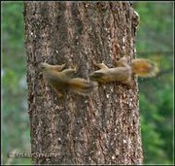

Slide 20
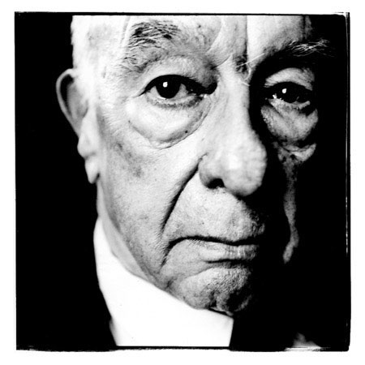
How Many Values of ‘e’-variables?
Alvin chased Theodore joyfully and athletically, but not skillfully.
∃e[Chased(e, Alvin, Theodore) & J(e) & A(e) & ~S(e)]
Theodore chased Alvin joylessly and unathletically, but skillfully.
∃e[Chased(e, Theodore, Alvin) & ~J(e) & ~A(e) & S(e)]
DISTINGUISH: the chases exhibit different properties that can be
specified adverbially or thematically
IDENTIFY: the “chases” exhibit the same sortal,
same participants, same spatiotemporal region
no two ships/statues/people/chipmunks/chases in the same place at the same time

Slide 21
How Many Values of ‘e’-variables?
Alvin chased Theodore joyfully and athletically, but not skillfully.
∃e[Chased(e, Alvin, Theodore) & J(e) & A(e) & ~S(e)]
Theodore chased Alvin joylessly and unathletically, but skillfully.
∃e[Chased(e, Theodore, Alvin) & ~J(e) & ~A(e) & S(e)]
DISTINGUISH, but RELATE: e1 ≠ e2, but e1 ≈ e2
IDENTIFY, but RELATIVIZE: a big ant can be a small animal;
a creature that is big for an ant can be a small for an animal

Slide 22
How Many Values of ‘e’-variables?
Alvin chased Theodore joyfully and athletically, but not skillfully.
∃e[Chased(e, Alvin, Theodore) & J(e) & A(e) & ~S(e)]
Theodore chased Alvin joylessly and unathletically, but skillfully.
∃e[Chased(e, Theodore, Alvin) & ~J(e) & ~A(e) & S(e)]
DISTINGUISH, but RELATE: e1 ≠ e2, but e1 ≈ e2
IDENTIFY, but RELATIVIZE: a quick swimming of the Channel can be (an event that is also) a slow crossing of the Channel;
an event can be joyful qua chase-by-Alvin yet
joyless qua chase-by-Theodore

Slide 23
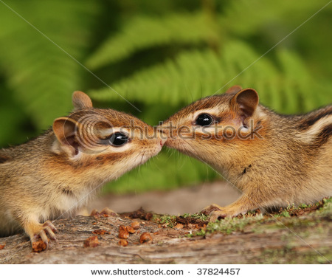
On the one hand...
Hilary and Ainsley kissed.
Each kissed the other, quite happily.
The activity was fully cooperative.
Nonetheless...
Hilary kissed Ainsley
a little more energetically than Ainsley kissed Hilary.
Ainsley kissed Hilary
a little more softly than Hilary kissed Ainsely.
Perhaps we can and should posit two kissings.
So perhaps it’s OK to posit two chasings.

Slide 24
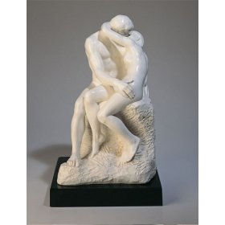
On another hand...
Positing two
facings/playings
seems less plausible.
So do we really have good reasons for proliferating chasings (or even kissings)?
Carnegie Deli faces Carnegie Hall.
Carnegie Hall faces Carnegie Deli.
Simon played a song on his tuba.
Simon played his tuba.
*The Kisses

Slide 25
On a third hand...
Simon played a song dramatically/on his tuba/in two minutes.
∃e[Played(e, Simon, a song) & Φ(e)]
Simon played his tuba skillfully/melodiously/for two minutes.
∃e[Played(e, Simon, his tuba) & Ψ(e)]
? Simon played a song skillfully/melodiously/for two minutes.
? ∃e[Played(e, Simon, a song) & Ψ(e)]
?? Simon played his tuba dramatically/on his tuba/in two minutes.
?? ∃e[Played(e, Simon, his tuba) & Φ(e)]

Slide 26
Outline
✓ Framing effects (e.g., Kahneman and Tversky)
✓ Some puzzles concerning natural language “event variables”
The chipmunks chased each other.
Alvin joyfully chased Theodore, who joylessly chased Alvin.
Simon played a song dramatically on his tuba in two minutes.
Simon played his tuba for two minutes.
With regard to alleged “values of” these event variables...
  Argue against identity responses to the puzzles
  Argue against non-identity responses to the puzzles
Given a truth-theoretic conception of linguistic meaning, certain framing effects are paradoxical

Slide 27
Against Simple Identity: NonEntailments
Simon played the song dramatically/on his tuba/in two minutes.
∃e[Played(e, Simon, the song) & Φ(e)]
Simon played his tuba skillfully/melodiously/for two minutes.
∃e[Played(e, Simon, his tuba) & Ψ(e)]
? Simon played the song skillfully/melodiously/for two minutes.
? ∃e[Played(e, Simon, the song) & Ψ(e)]
It seems to depend on the details and operative standards.

Slide 28
Against Simple Identity: NonEntailments
Simon played the song dramatically/on his tuba/in two minutes.
∃e[Played(e, Simon, the song) & Φ(e)]
Simon played his tuba skillfully/melodiously/for two minutes.
∃e[Played(e, Simon, his tuba) & Ψ(e)]
?? Simon played his tuba dramatically/on his tuba/in two minutes.
?? ∃e[Played(e, Simon, his tuba) & Φ(e)]
Here, identification just seems wrong.

Slide 29
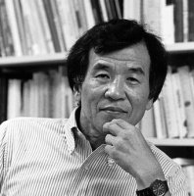
So maybe we should Distinguish after all...
Simon played the song.
∃e[Played(e, Simon, the song)]
Played(e1, Simon, the song)
Simon played his tuba.
∃e[Played(e, Simon, his tuba)]
Played(e2, Simon, his tuba)
DISTINGUISH, but RELATE: e1 ≠ e2, but e1 ≈ e2
My Claim: while this strategy is plausible for some
cases, it is not plausible for these cases

Slide 30
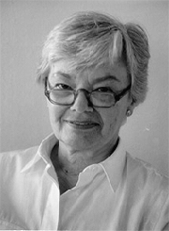
Plausible Cases of “Distinct but Related”
Booth shot Lincoln with a pistol
Booth pulled the trigger with his finger
It seems that (modulo some niceties)
the pulling was a part of the shooting...
the pulling ended before the shooting did
Booth didn’t shoot Lincoln with his finger
Booth didn’t pull the trigger with a pistol
Booth pulled the trigger long before Lincoln died
? Booth killed Lincoln long before Lincoln died
It seems that (modulo some niceties)
the trigger-pulling was a nonfinal part of the killing
|---------|-----------|----------|
finger trigger pistol
squeezed pulled shot

Slide 31
Plausible Cases of “Distinct but Related”
Booth shot Lincoln with a pistol
Booth pulled the trigger with his finger
It seems that (modulo some niceties)
the pulling was a part of the shooting...
the pulling ended before the shooting did
Booth didn’t shoot Lincoln with his finger
Booth didn’t pull the trigger with a pistol
But each chipmunk-chase has the same spatiotemporal features/participants.
Likewise, it seems, for Simon’s song-playing and his tuba-playing.
|---------|-----------|----------|
finger trigger pistol
squeezed pulled shot

Slide 32
Not Implausible Cases of “Distinct but Related”
Grant that statues are not lumps of clay (fusions of molecules, etc.)
The artist made the statue
The artist did not make the lump of clay
The statue can lose a bit (and still be the same statue)
The fusion of molecules cannot lose a bit (and be the same fusion)
Let’s even grant that if a sphere is rotating and heating,
then the rotating is distinct from the heating
In these cases, it seems to be important that the sortal differs:
no two statues/fusions/rotatings/heatings/(chases?)
in the same place at the same time

Slide 33
Less Plausible Cases of “Distinct but Related”
Simon played the song
Simon played his tuba
Simon played his favorite record
Simon played his favorite song
Simon played a hit record
(While working as a DJ) Simon played a Beatles tune on the radio
Russell: retain a “robust sense of reality”
Davidson: genuine values of variables are describable in many ways
Are these different event sortals?
And if so, what linguistic differences
don’t make for different sortals?

Slide 34
Less Plausible Cases of “Distinct but Related”
Simon played the song
Simon played his tuba
If any grammatical difference can make for a sortal difference,
in a way that allows for distinct but co-located events...
Simon played the song on Monday
Simon played the song on his tuba
Simon played the song on his tuba on Monday
...then why think that the song-playing is
a song-playing on a tuba on Monday?

Slide 35
So maybe we should Identify after all...
Simon played the song dramatically/on his tuba/in two minutes.
∃e[Played(e, Simon, the song) & Φ(e)]
Simon played his tuba skillfully/melodiously/for two minutes.
∃e[Played(e, Simon, his tuba) & Ψ(e)]
?? Simon played his tuba dramatically/on his tuba/in two minutes.
?? ∃e[Played(e, Simon, his tuba) & Φ(e)]
IDENTIFY, but RELATIVIZE: a song-playing that is a tuba-playing
can be Dramatic/OnHisTuba/InTwoMinutes qua song-playing
yet fail to be Dramatic/OnHisTuba/InTwoMinutes qua tuba-playing
My Claim: while this strategy is plausible for some cases,
it is not plausible for these cases

Slide 36
Plausible Cases of “Identify but Relativize”
Every big ant is (still) a small animal.
The good wrench was a poor weapon.
And perhaps...
Simon played his tuba well, but he did not play the song well.
∃e[Played(e, Simon, his tuba) & Well(e)] &
~∃e[Played(e, Simon, the song) & Well(e)]
Simon’s playing of his tuba was a good one, but
his playing of the song was not a good one.

Slide 37
In Favor of Relativization, Sometimes
The concept good-for (good-as, good-one)
may be more basic than good simpliciter.
And likewise for many adjectives (e.g., ‘big’)
that plausibly lexicalize relational concepts.
’big ant’ → BigAnt(x) → Ant(x) & Big(x)
→ ιX:Ant(X)[BigOne(x, X)]
∃e[Played(e, Simon, his tuba) & GoodOne(e, PlayingOfHisTuba)] &
~∃e[Played(e, Simon, the song) & GoodOne(e, PlayingOfTheSong)]

Slide 38
Less Plausible Cases of “Identify but Relativize”
Simon played the song on his tuba in two minutes.
∃e[Played(e, Simon, the song) & OnHisTuba(e) & InTwoMinutes(e)]
Played(e1, Simon, the song) & OnHisTuba(e1) & InTwoMinutes(e1)
Simon played his tuba for two minutes.
∃e[Played(e, Simon, his tuba) & ForTwoMinutes(e)]
Played(e2, Simon, his tuba) & ForTwoMinutes(e2)
(e1 = e2) ➔ ∃e[Played(e, Simon, the song) & Played(e, Simon, his tuba)
& OnHisTuba(e) & InTwoMinutes(e) & ForTwoMinutes(e)]

Slide 39
Less Plausible Cases of “Identify but Relativize”
Simon played the song on his tuba in two minutes.
∃e[Played(e, Simon, the song) & OnHisTuba(e) & InTwoMinutes(e)]
Played(e1, Simon, the song) & OnHisTuba(e1) & InTwoMinutes(e1)
Simon played his tuba for two minutes.
∃e[Played(e, Simon, his tuba) & ForTwoMinutes(e)]
Played(e2, Simon, his tuba) & ForTwoMinutes(e2)
(e1 = e2) ➔ ∃e[Played(e, Simon, his tuba) & OnHisTuba(e) & InTwoMinutes(e)]
?? Simon played his tuba on his tuba. (weird thought, but grammatical)
?? Simon played his tuba in two minutes. (somehow ungrammatical, despite
an available unweird thought)

Slide 40
if it is true that
∃e[Played(e, Simon, the song) & Played(e, Simon, his tuba) &
OnHisTuba(e) & InTwoMinutes(e) & ForTwoMinutes(e)]
then why can’t we understand the following as true sentences?
Simon played his tuba on his tuba.
Simon played his tuba in two minutes.
Simon played his tuba on a brass instrument in two minutes.
Simon played his tuba on a brass instrument for a tuba-playing.
Simon played his tuba in two minutes for a tuba-playing.

Slide 41
Telicity Worry about Identifying/Relativizing
Simon jogged to the park in an hour, getting there at 2pm.
Simon jogged for an hour, ending up in the park at 2pm.
*Simon jogged in an hour, thereby getting to the park at 2pm.
But if the jogging to the park is the jogging, which ends in the park,
then that event is both In-An-Hour and For-an-Hour.
______________________________________________________________
Simon put the polish on the brass for/in an hour.
Simon polished the brass for/in an hour.
Simon put polish on the brass for/*in an hour.
Simon polished brass for/*in an hour.
If the putting of (the) polish on the brass is the polishing of (the) brass,
then that event is both In-an-Hour and For-an-Hour.
Different
event sortals?

Slide 42
Another Worry About Identifying
Simon played the song.
∃e[Player(e, Simon) & PastPlaying(e) & ThingPlayed(e, the song)]
Player(e1, Simon) & PastPlaying(e1) & ThingPlayed(e1, the song)
Simon played his tuba.
∃e[Agent(e, Simon) & PastPlaying(e) & ThingPlayed(e, his tuba)]
Player(e2, Simon) & PastPlaying(e2) & ThingPlayed(e2, his tuba)
(e1 = e2) ➔ one event of Playing has more than one ThingPlayed
Can one “e-variable value” have two participants of the same sort?
Simon lifted the piano.
∃e[Lifter(e, Simon) & Lifted(e) & ThingLifted(e, the piano)]

Slide 43
Another Worry About Identifying
Simon played the song.
∃e[Player(e, Simon) & PastPlaying(e) & ThingPlayed(e, the song)]
Player(e1, Simon) & PastPlaying(e1) & ThingPlayed(e1, the song)
Simon played his tuba.
∃e[Agent(e, Simon) & PastPlaying(e) & ThingPlayed(e, his tuba)]
Player(e2, Simon) & PastPlaying(e2) & ThingPlayed(e2, his tuba)
(e1 = e2) ➔ one event of Playing has more than one ThingPlayed
Alvin joyfully chased Theodore, who joylessly chased Alvin.
(e1 = e2) ➔ one event of Chasing has two Chasers and two Chasees

Slide 44
Outline
✓ Framing effects (e.g., Kahneman and Tversky)
✓ Some puzzles concerning natural language “event variables”
Two chipmunks chased each other.
Alvin joyfully chased Theodore, who joylessly chased Alvin.
Simon played a song dramatically on his tuba in two minutes.
Simon played his tuba for two minutes.
✓ With regard to alleged “values of” these event variables...
  Argue against identity responses to the puzzles
  Argue against non-identity responses to the puzzles
Given a truth-theoretic conception of linguistic meaning, certain “event framing effects” yield paradoxes
(so maybe the truth-theoretic conception is wrong)

Slide 45
1. ~[Deduction(r) > Deduction(p)] Desire
2. Surcharge(p) < Surcharge(r) Desire
3. for any income i,
Surcharge(i) = Deduction(i) obvious, but also provable
4. Surcharge(r) = Deduction(r) [3]
5. Surcharge(p) < Deduction(r) seems OK [2, 4]
6. Surcharge(p) = Deduction(p) [3]
7. Deduction(p) < Deduction(r) seems bad [5, 6]
8. Deduction(r) > Deduction(p) [7]
9. ⊥ [17, 3]
some intuitions may not have stable propositional contents
in some domains, it may not be possible to characterize our psychological states in terms of frame-independent contents

Slide 46
Recall Kahneman’s Conclusion:
Framing Effects can Run Deep
“The message about the nature of framing is stark: framing should not be viewed as an intervention that masks or distorts an underlying preference. At least in this instance...there is no underlying preference that is masked or distorted by the frame. Our preferences are about framed problems, and our moral intuitions are about descriptions, not substance.”
Maybe it’s not always this bad with regard to the moral/political.
But note how confused we can get when describing
“what happened” in a case of two animals chasing each other--
two interacting agents, each with their own goals.
Notes:
OK to here

Slide 47
A Potential Analogy
Alvin joyfully chased Theodore, who joylessly chased Alvin.
Linguistic framing does not “distort our intuitions” about
how expressions are related to language-independent events.
We don’t have such “intuitions” in the first place.
Externalism about linguistic meaning is a dogma, not a truism.
Our “semantic intuitions” reflect human linguistic expressions, and how
they relate to human concepts, whose relation to truth is complicated.
Logical Forms like ∃e[Chased(e, Alvin, Theodore) & Joyful(e)]
don’t specify truth conditions for human language sentences.
They are more like “model thoughts” that might be formed by “ideal” agents who settle in advance what shall count as a chase, and then let the chips fall where they may with regard to which thoughts/sentences are true.

Slide 48
A Potential Analogy
Alvin joyfully chased Theodore, who joylessly chased Alvin.
Linguistic framing does not “distort our intuitions” about
how expressions are related to language-independent events.
We don’t have such “intuitions” in the first place.
Externalism about linguistic meaning is a dogma, not a truism.
Our “semantic intuitions” reflect human linguistic expressions, and how
they relate to human concepts, whose relation to truth is complicated.
Logical Forms like ∃e[Chased(e, Alvin, Theodore) & Joyful(e)]
don’t specify truth conditions for human language sentences.
Human meanings need not be functions from contexts to truth conditions. They can be “instructions” for how to assemble concepts/thoughts, which need not be “ideal” concepts/thoughts

Slide 49
Event Variables: Alleged Argument for TCS
Alvin chased Theodore.
∃e[Chased(e, Alvin, Theodore)]
Alvin chased Theodore joyfully.
∃e[Chased(e, Alvin, Theodore) & Joyful(e)]
Alvin chased Theodore around a tree.
∃e[Chased(e, Alvin, Theodore) & ∃x{Around(e, x) & Tree(x)}]
Alvin chased Theodore joyfully around a tree.
∃e[Chased(e, Alvin, Theodore) & Joyful(e)
& ∃x{Around(e, x) & Tree(x)}]

Slide 50
Conjunct Reduction: No Variables Needed
Alvin chased Theodore.
∃[Chased(_, Alvin, Theodore)]
Alvin chased Theodore joyfully.
∃[Chased(_, Alvin, Theodore)^Joyful(_)]
Alvin chased Theodore around a tree.
∃[Chased(_, Alvin, Theodore)^∃{Around(_, _)^Tree(_)}]
|________________|
Alvin chased Theodore joyfully around a tree.
∃[Chased(_, Al, Theo)^Joyful(_)^∃{Around(_,_)^Tree(_)}]

Slide 51
Nearly Truistic:
sentences (of a natural human language) have meanings
sentences can be used to express thoughts that are true or false
speakers’ judgments can be useful data for theories of meaning
Davidson’s Conjecture: natural human sentences have truth conditions
The alleged evidence (our “semantic intuitions”) may not reflect the
coherence and stability required by truth-evaluable content.
On the contrary, The Conjecture may imply...
Event Paradoxes (‘The chase was both joyful and joyless’)
Referent Paradoxes (‘She visited Venice after it had been moved’)
Liar Paradoxes (‘The last example sentence in this talk is not true’)

Slide 52
I find myself torn between two conflicting feelings— a ‘Chomskyan’ feeling that deep regularities in natural language must be discoverable by an appropriate combination of formal, empirical, and intuitive techniques, and a contrary (late) ‘Wittgensteinian’ feeling that many of the ‘deep structures’, ‘logical forms’, ‘underlying semantics’ and ‘ontological commitments’, etc., which philosophers have claimed to discover by such techniques are Luftgebäude.
Saul Kripke, 1976
Is there a Problem about Substitutional Quantification?

Slide 53
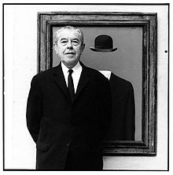
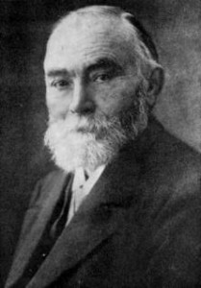
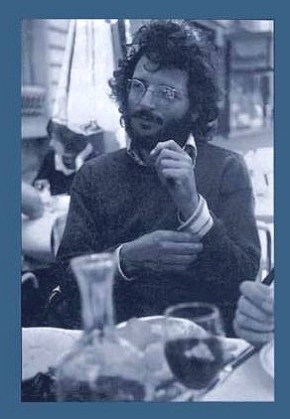
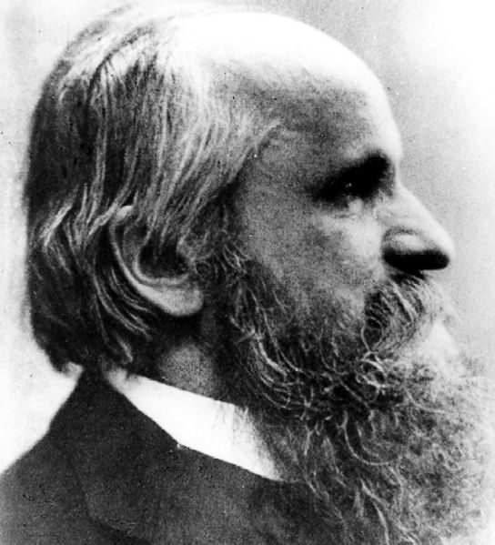
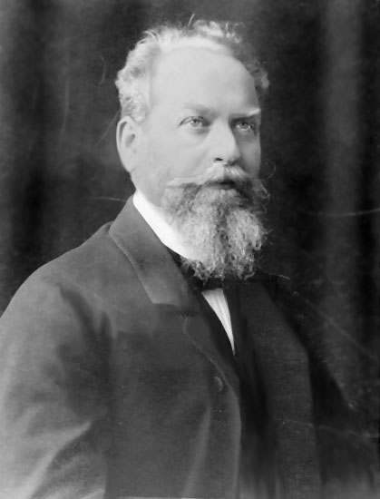
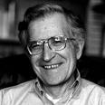
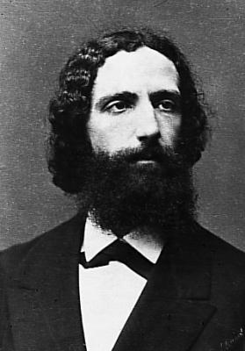
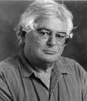
To Represent is to
Represent in a Particular Way...
sometimes, without
re-presenting representable things

Slide 54
Event Variables and Framing Effects
THANKS!

